Slide 1


Ecomm Company
Investor Pitch
By
CHITRA PARSAILA
PRABHJOT SINGH
RITIK SHARMA
SAKTHI JANANI

Slide 2
Ecomm Company
Agenda
01
Executive Summary
02
Where We Are Now
03
Let Talk Numbers
04
Trend Report
05
Where are we headed
06
Conclusion

Slide 3



Company overview
Ecomm Company
Our e-commerce startup specializes in selling high-quality stuffed animal toys, tapping into a growing market of consumers seeking unique, comforting, and collectible plush toys.
Current position in the market
As a newly launched company, we have quickly established our brand and garnered a loyal customer base.
Executive Summary
Vision
We are now preparing for our next funding round to accelerate growth and enhance our market presence.

Slide 4
Where We Are Now
Ecomm Company
In the following slides, we will provide a comprehensive overview of our current business performance and market position. Here’s what to expect:
Current Performance Metrics:
Overview of key performance indicators (KPIs) including site traffic, sales trends, and customer engagement.
Insights into traffic sources and their impact on overall performance.
Traffic Analysis:
Breakdown of website traffic by source, including search engines, social media, and direct visits.
Examination of traffic patterns and peak engagement times.
Product Performance:
Analysis of sales trends for existing products and performance metrics for newly launched items.
Evaluation of refund rates and customer feedback to assess product quality and satisfaction.
BACK TO AGENDA PAGE

Slide 5
Where We Are Now
Ecomm Company
4. Seasonality and Trends:
Identification of seasonal trends affecting sales and traffic.
Insights into promotional opportunities and market dynamics.
5. Detailed Analytics:
Review of traffic source effectiveness and performance of free versus paid channels.
Cross-sell and portfolio expansion opportunities based on product performance data.
These slides will provide a clear picture of our current business standing and set the foundation for our future growth strategy.
BACK TO AGENDA PAGE

Slide 6

Ecomm Company
LET’S TALK NUMBERS
BACK TO AGENDA PAGE

Slide 7
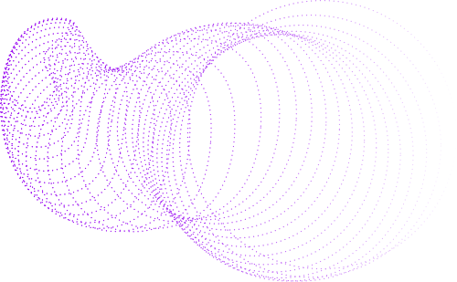
Ecomm Company
Total Revenue | $1.94M
Total Orders | 32K
AOV | $60
Total Session | 473K
Conversion Rate | 6.83%
Gross Profit | $1.2M
Total Customer | 394K
Summary
BACK TO AGENDA PAGE

Slide 8
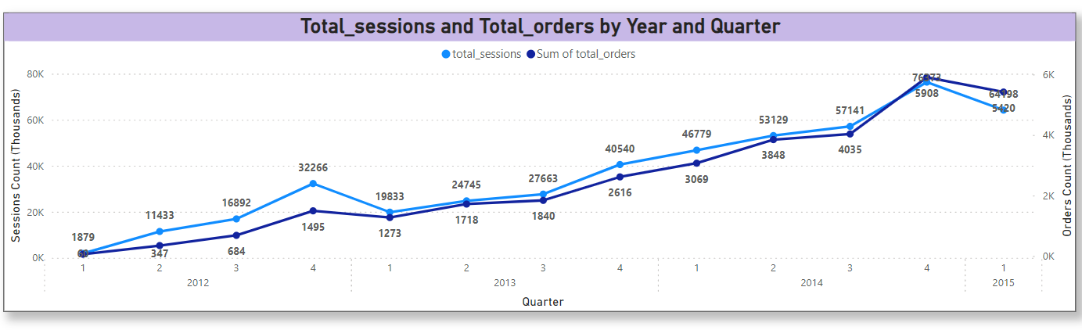
Volume Growth
INSIGHTS:
Steady Growth: There is a clear upward trend in both total sessions and total orders over time, indicating steady growth in user engagement and sales.
Seasonal Trends: There seems to be a notable increase in both sessions and orders in Q4 of each year, which could indicate higher activity during holiday seasons or end-of-year promotions.

Slide 9
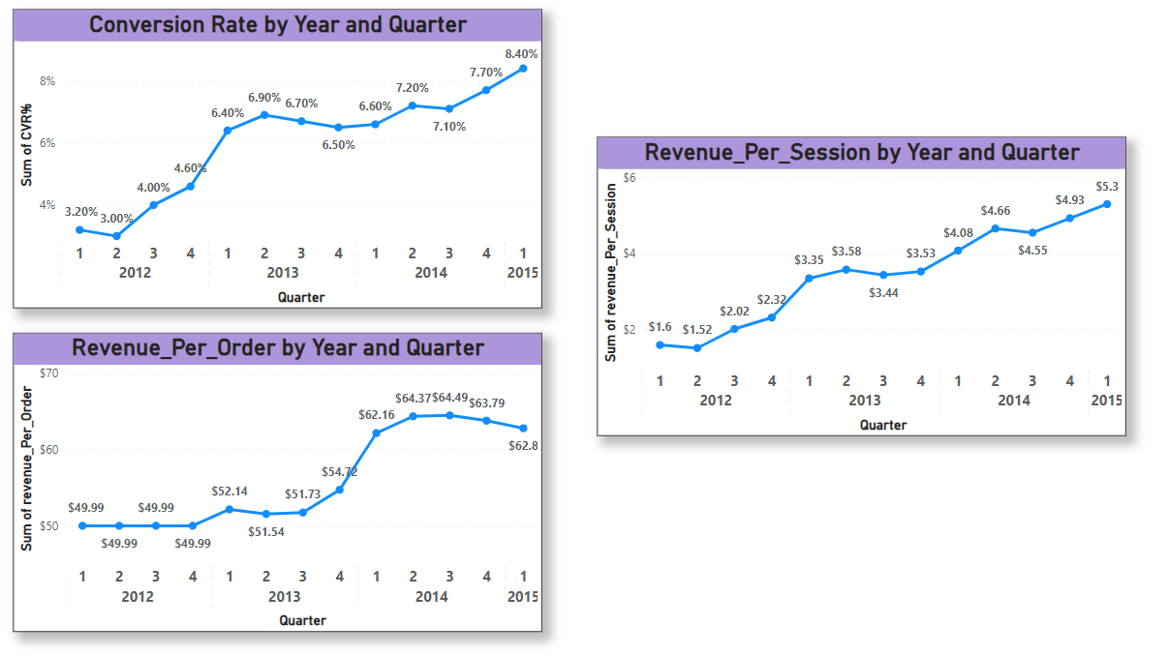
Efficiency improvements
INSIGHTS:
There has been a consistent increase in CVR%, indicating improved effectiveness in converting sessions to orders.
Significant increases in revenue per order are seen.
The steady increase in revenue per session indicates that the company is not only driving more visitors but also generating more revenue from each user interaction.
BACK TO AGENDA PAGE

Slide 10
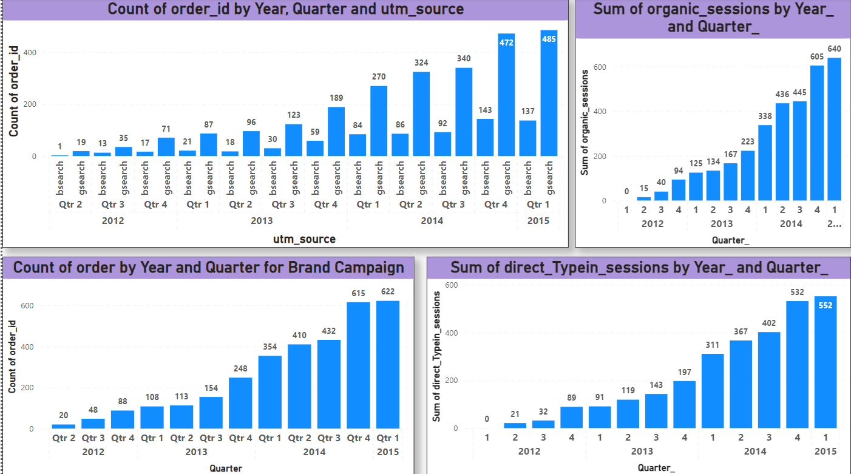
Specific Channels Growth

Slide 11
Specific Channels Growth
INSIGHTS:
Overall Growth: There is a clear upward trend in the number of sessions from all channels over time.
G Search (Nonbrand): This channel has grown substantially over the quarters, from 60 sessions in Q1 2012 to 3,025 in Q1 2015. This suggests increasing effectiveness of Google non-branded search campaigns.
Brand Search: The number of sessions from brand searches has generally increased, indicating growing brand recognition and effectiveness of brand-related campaigns.
Organic Search: This channel has grown steadily, reflecting ongoing improvements in SEO and organic reach.
Direct Type-in: This channel shows consistent growth, indicating that users are directly typing in the website URL or have bookmarked the site(reflects increasing brand loyalty.

Slide 12
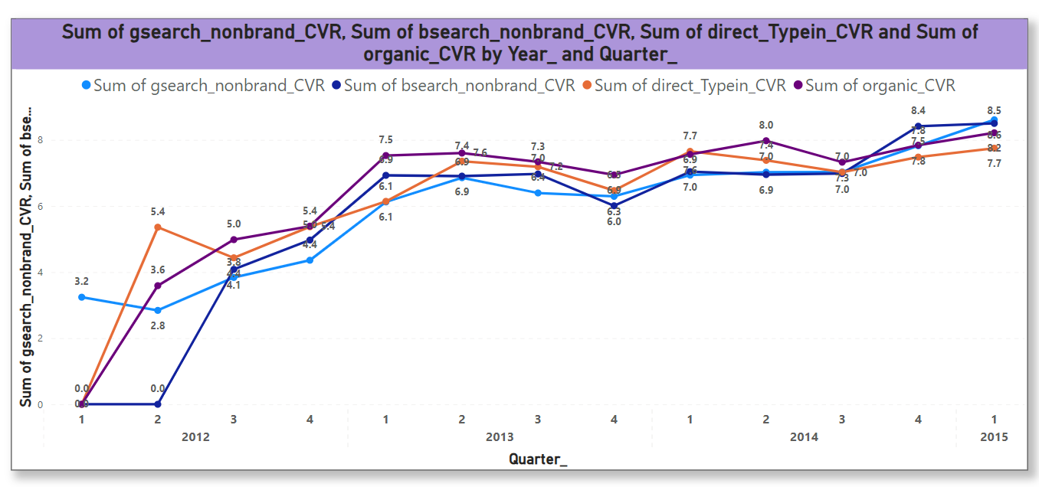
Conversion Rate Trend
BACK TO AGENDA PAGE

Slide 13
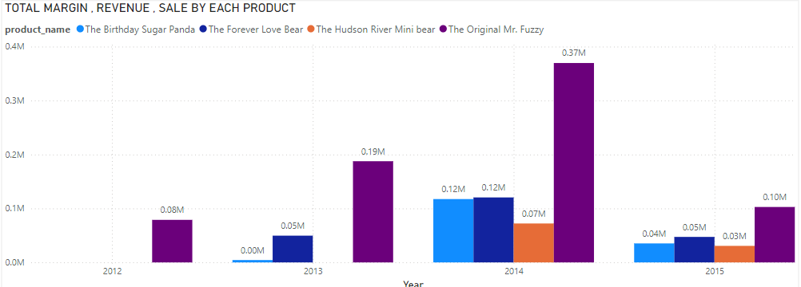
5
Product and Seasonal Strategy
BACK TO AGENDA PAGE

Slide 14
5
Best-Selling Product:
"The Original Mr. Fuzzy" leads in both sales and profitability, showing consistent growth across all months.
Seasonal Trends:
"The Forever Love Bear" peaks in February, popular for Valentine's Day.
"The Birthday Sugar Panda" maintains steady sales year-round, with peaks during gift-giving months.
"The Hudson River Mini Bear" sees increased sales during the holiday season.
Margin Insights:
All products show stable margins, with higher margins during peak sales months.
"The Original Mr. Fuzzy" not only tops sales but also delivers the highest margins.
Holiday Impact:
Significant sales and revenue increases during November and December, aligning with holiday gift purchases.
Our strategic product diversification and targeted marketing efforts have driven sustainable growth and strengthened our market position.

Slide 15
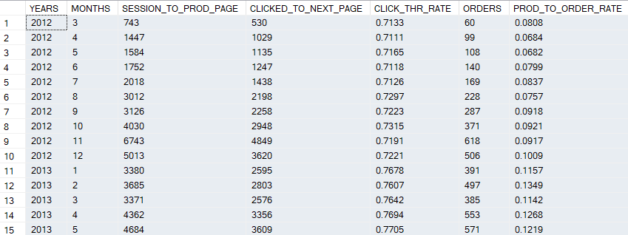
Impact of introducing new products
6

Slide 16
6
Key highlights include:
Monthly Trends: Consistent growth patterns in revenue and margins, reflecting strong market demand.
Seasonality Insights: Identified seasonal peaks and steady growth, aiding in effective inventory and marketing strategies.
Our user engagement metrics have also improved significantly:
Click-Through Rate: Increased from 71% to 85%.
Conversion Rate: Doubled from 7% to 14%.
Strategic moves driving this growth:
New Product Additions: Attracting a broader audience.
Competitive Pricing: Increasing customer base and loyalty.
These improvements highlight the robust health and sustainable growth of our business. Thank you for your continued support.

Slide 17
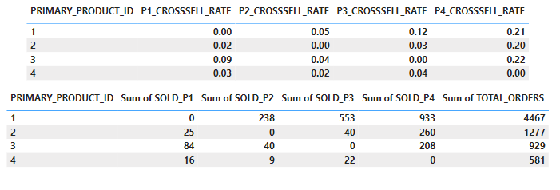
Maximizing Sales Through Strategic Cross-Selling
7

Slide 18
7
Maximizing Sales Through Strategic Cross-Selling
7
Our strategic shift on December 5, 2014, to make our fourth product a primary offering has shown promising results. Here are the key highlights:
Top-Selling Products:
Product 1 leads in sales, followed by products 2 and 3.
Product 4, though less often a primary product, excels in cross-selling.
Cross-Selling Success:
Product 4 effectively cross-sells with products 1, 2, and 3, appearing in over 20% of their orders.
Product 3 shows a notable cross-sell rate with Product 1.
Our data-driven cross-selling strategy has significantly boosted revenue and customer satisfaction. We are excited about these insights and look forward to continued growth.

Slide 19
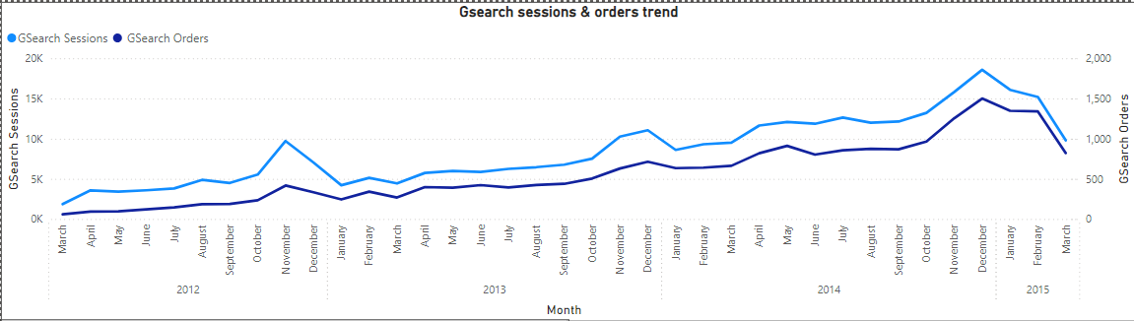
9
GSearch Volume Growth
INSIGHTS
There is a clear upward trend in both sessions and orders over time, indicating steady growth in user engagement and sales.
There seems to be a spike in both sessions and orders in Q4 of each year, which could indicate higher activity during Christmas.

Slide 20
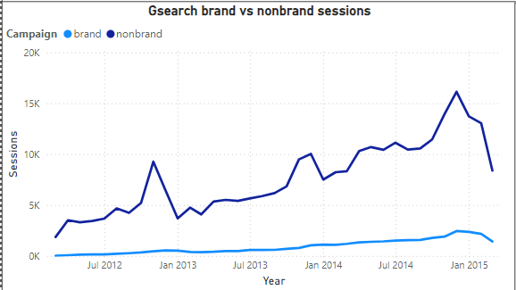
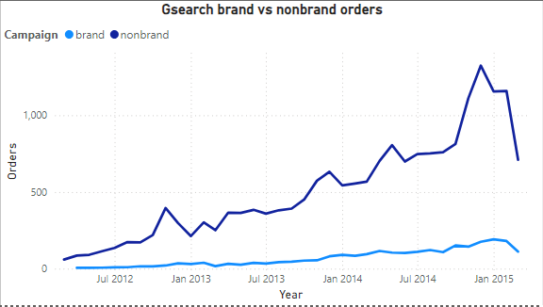
10
Brand vs Nonbrand Trends
Insights
Brand: The strong growth and peak performance in brand campaign highlights the importance of brand recognition and loyalty in influencing consumer behaviour.
Non-Brand : They contribute less significantly to overall performance, they provide a stable baseline of sessions and orders, indicating that non-brand campaigns play a role in maintaining steady engagement and conversions.

Slide 21
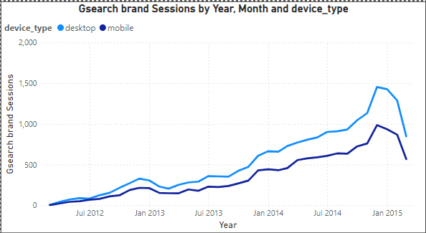
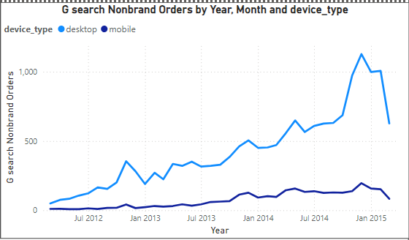
11
Desktop vs Mobile Nonbrand Trends
Insights
Desktop consistently outperforms mobile in both nonbrand orders and sessions. The gap between desktop and mobile is quite significant, indicating that desktop was the preferred device for nonbrand searches leading to orders and sessions during this period.

Slide 22
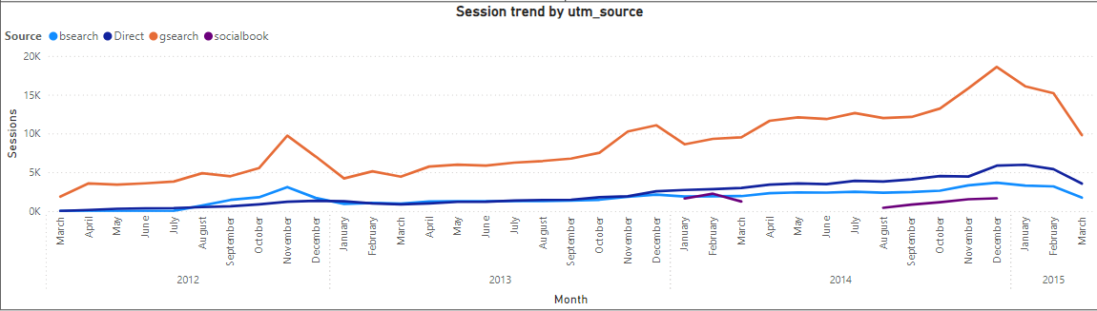
12
Growth of Traffic by Channels
Insights
The sharp rise in bsearch sessions, especially the peak in late 2014, indicates the increasing role of gsearch in attracting traffic.
Direct sessions shows a consistent upward trend. This indicates a steady contribution to overall traffic, likely from sources not explicitly categorized.

Slide 23
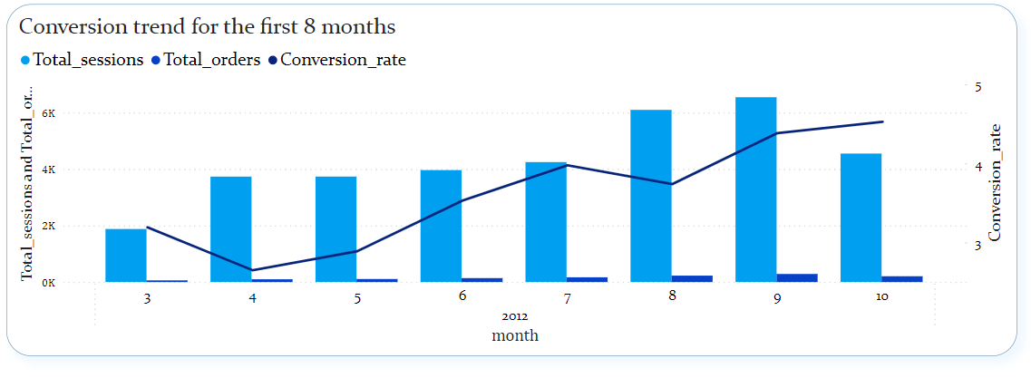
Conversion Trend
13
BACK TO AGENDA PAGE

Slide 24
Conversion Trend
13
Insights:
Steady Growth in Sessions: Our session count showed a consistent upward trend, increasing from March to September, indicating growing interest and traffic to our platform.
Rising Conversion Rates: Despite the total orders remaining consistently low, our conversion rate—a critical measure of turning visits into sales—steadily improved from May to September, peaking in October. This highlights our successful efforts in optimizing the user journey and improving the overall effectiveness of our website.
This consistent performance improvement demonstrates our capability to attract and convert customers effectively, positioning us well for continued expansion and success.
.

Slide 25
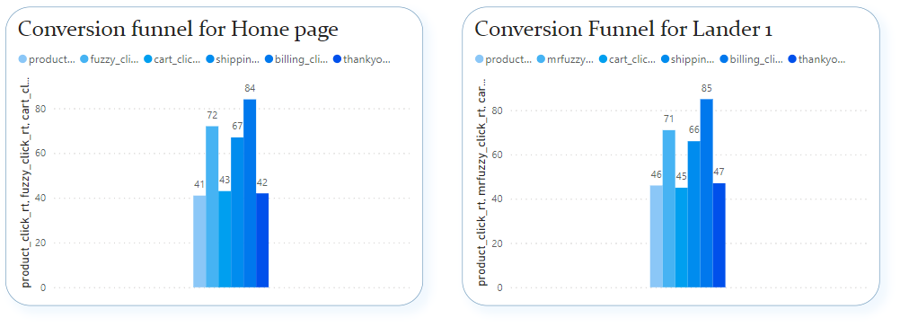
Conversion Funnel
15
This analysis of landing page performance (June 19 - July 28), we tracked user behavior from initial visit through to order completion of two landing page.

Slide 26
Conversion Funnel
15
15
Insights:
Strong Initial Engagement:
Homepage: Attracted a significant volume of sessions, showing broad user interest.
Lander-1: Focused user engagement, with visitors progressing effectively through the conversion stages.
Effective Funnel Progression:
Product Page Clicks: High click-through rates to product pages, indicating compelling initial content.
Continued User Journey: Consistent movement through the cart, shipping, and billing pages, showcasing a smooth and intuitive user experience.
Successful Conversions:
Thank You Page Visits: High conversion rates at the final stage, particularly for users starting from Lander-1, confirming the success of our targeted landing page strategy.
Lander-1, in particular, demonstrates superior performance, making it a key component of our optimization strategy.

Slide 27
Billing Vs Billing -2
16
16
AIM: Billing test from Sep 10 - Nov 10, 2012, aimed at analyzing the performance of our newly introduced billing page, /billing-2, alongside our existing /billing page.
Insights:
The revenue per session for the /billing page remained consistent before and during the test. Despite a reduction in the number of sessions, the revenue efficiency per session was stable, indicating that the changes did not impact revenue per session for this page.
The new /billing-2 page, introduced after September 9, 2012, has shown strong initial performance with a revenue per session of $49.99. This indicates that the new page is effectively generating revenue and contributing positively to our overall billing process.
The test results validate the performance of the new /billing-2 page and confirm the stability of the existing /billing page's revenue efficiency. The introduction of the new page has been successful, and its positive performance is a strong indication of its value.

Slide 28
Quick Recap: Our Performance So Far
Surge in Volume: Order volume grew a hundredfold, with a significant rise in sessions, showing rapid customer expansion.
Efficiency Gains: Conversion rate improved from 3.2% to 8.4%, boosting revenue per order and session.
Channel Shift: Orders increased across all channels, with a reduced reliance on paid marketing.
Seasonal Product Trends: Products like 'mrfuzzy' and 'lovebear' showed strong seasonal demand, with peaks during holidays and Valentine's Day. Early data suggests similar patterns for 'birthdaybear' and 'minibear.'
Product Page Optimization: Click-through rates improved from 71% to 85%, and conversions from product page to order rose from 8% to 14%, reflecting successful website enhancements.
Cross-Selling Success: Making the fourth product a primary option boosted overall sales, especially for the lower-priced add-on items.

Slide 29

Use of Funds
45% on Product Development and Expansion
20% on Technology and Infrastructure
35% on Marketing and Customer Acquisition
Where We
Are Headed
BACK TO AGENDA PAGE

Slide 30
Use Of Funds
Marketing and Customer Acquisition:
Enhance brand recognition through advertising campaigns on various platforms such as Google,
Bing and Social media.
Invest in SEO and content marketing to increase organic traffic.
Product Development:
Expand the product line by developing new stuffed animal toys.
Improve the quality of ‘The Birthday Sugar Panda’ as it is having the highest refund rate
Technology and Website Improvements:
Upgrade the e-commerce platform to enhance user experience, speed, and security.
Implement advanced analytics tools to better understand customer behavior and improve conversion rates.

Slide 31
Use Of Funds
Talent Acquisition and Team Expansion:
Hire additional staff in key areas such as marketing, product development, customer service, and technology.
Invest in training and development programs for existing employees
Customer Experience Enhancements:
Develop and launch new features that enhance the shopping experience, such as personalized recommendations, loyalty programs, and improved customer support.
Our focused allocation of funds will enable us to:
Accelerate growth and scale operations effectively.
Enhance our product offerings and maintain a competitive edge.
Optimize customer experience and increase brand loyalty.
Achieve our financial and strategic goals, delivering long-term value to our investors.

Slide 32
Conclusion
Strong Foundation: We have demonstrated solid performance with promising growth metrics and a loyal customer base.
Strategic Vision: Our future plans include scaling operations, enhancing our product offerings, and optimizing marketing strategies to drive continued growth.
Investment Opportunity: We are poised to leverage this momentum and seek your support to accelerate our journey and achieve our ambitious goals.

Slide 33
Join Us in Shaping the Future
We invite you to be a part of our exciting journey as we expand our presence in the e-commerce market for stuffed animal toys. Your investment will enable us to enhance our capabilities, drive innovation, and capture significant market share.

Slide 34
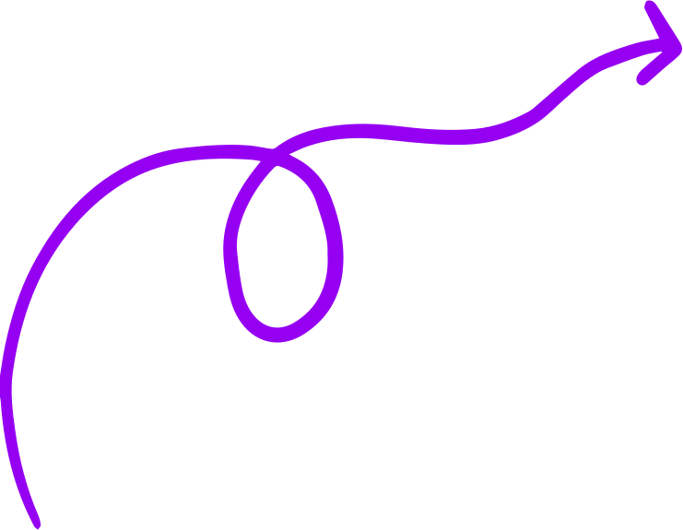
Thank you for your time!
Reach out to us for questions.
www.ecommercesite.com
hello@ecommercesite.com
123-456-7890
BACK TO AGENDA PAGE

Slide 35
Suggestion: The factory is poised for continued growth. Future success lies in product diversification, platform optimization, and enhancing customer experience. Leveraging data analytics for personalized marketing and exploring new market segments could drive the next growth phase.
Conclusion: Maven Fuzzy Factory's success story highlights the power of data-driven insights, creative marketing, and a strong customer focus. The company's progress emphasizes the need for adaptable strategies and customer-centric product development in a competitive digital market.

